Slide 1
MVC. Building Ruby on Rails
Application
Igor Kasyanchuk

Slide 2
Agenda
What is MVC
Ruby on Rails. Quick Introduction.
Models
Views
Controllers
Building Rails Application
Idea
Tools
Final Steps
Example
Questions and Answers

Slide 3
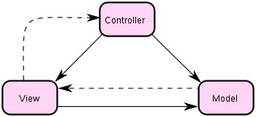
MVC
Model/View/Controller (MVC) pattern creates applications that separate the different aspects of the application (input logic, business logic, and UI logic), while providing a loose coupling between these elements (wikipedia).

Slide 4

Ruby on Rails
It’s a framework, not language.
It’s young (2004).
Popular? - Tiobe index.
Reality. What we have now?
RoR Paradigms
Naming over Configuration
DRY
Future.

Slide 5

Models
A model represents the information (data) of the application and the rules to manipulate that data. In the case of Rails, models are primarily used for managing the rules of interaction with a corresponding database table. In most cases, each table in your database will correspond to one model in your application. The bulk of your application’s business logic will be concentrated in the models.

Slide 6
Views
Views represent the user interface of your application. In Rails, views are often HTML files with embedded Ruby code that perform tasks related solely to the presentation of the data. Views handle the job of providing data to the web browser or other tool that is used to make requests from your application.

Slide 7
Controllers
Controllers provide the “glue” between models and views. In Rails, controllers are responsible for processing the incoming requests from the web browser, interrogating the models for data, and passing that data on to the views for presentation.

Slide 8
Building Rails Application
1. Installing Rails and creating new application
2. Configuring and creating a Database
4. Starting up the Web Server
5. Magic
6. Deploying application

Slide 9


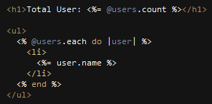
Magic
Model. View. Controller. How it works?

Slide 10
Idea
How to start?
What to do?
When?
Measure results.

Slide 11
Tools
Ruby
Ruby on Rails
Gems
Utilities
Linux
Web Developer Tools (Chrome, FF)

Slide 12
Final Steps
Hosting
Code
Server
Application Support
Start new Facebook or Twitter
Keep studying, help community, participate in forums, groups

Slide 13
Example
Let’s do it

Slide 14
Useful links
http://rubyonrails.org/
http://guides.rubyonrails.org/
http://heroku.com
http://github.com
http://www.tiobe.com/index.php/paperinfo/tpci/Ruby.html
http://railsinstaller.org/
And others ….

Slide 15


Questions?

Slide 16


